Slide 1
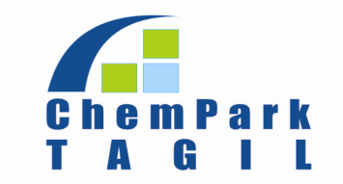
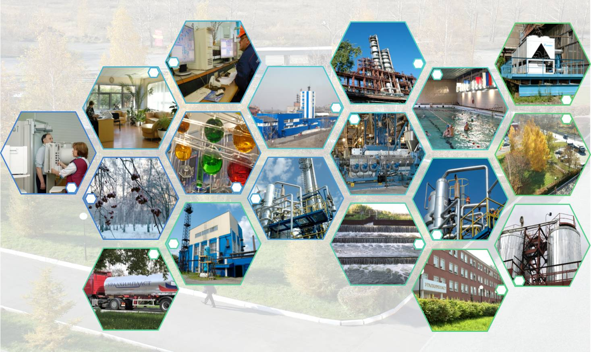
«Chemical Park Tagil»
Notes:
1

Slide 2
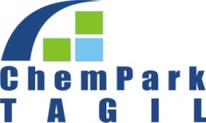
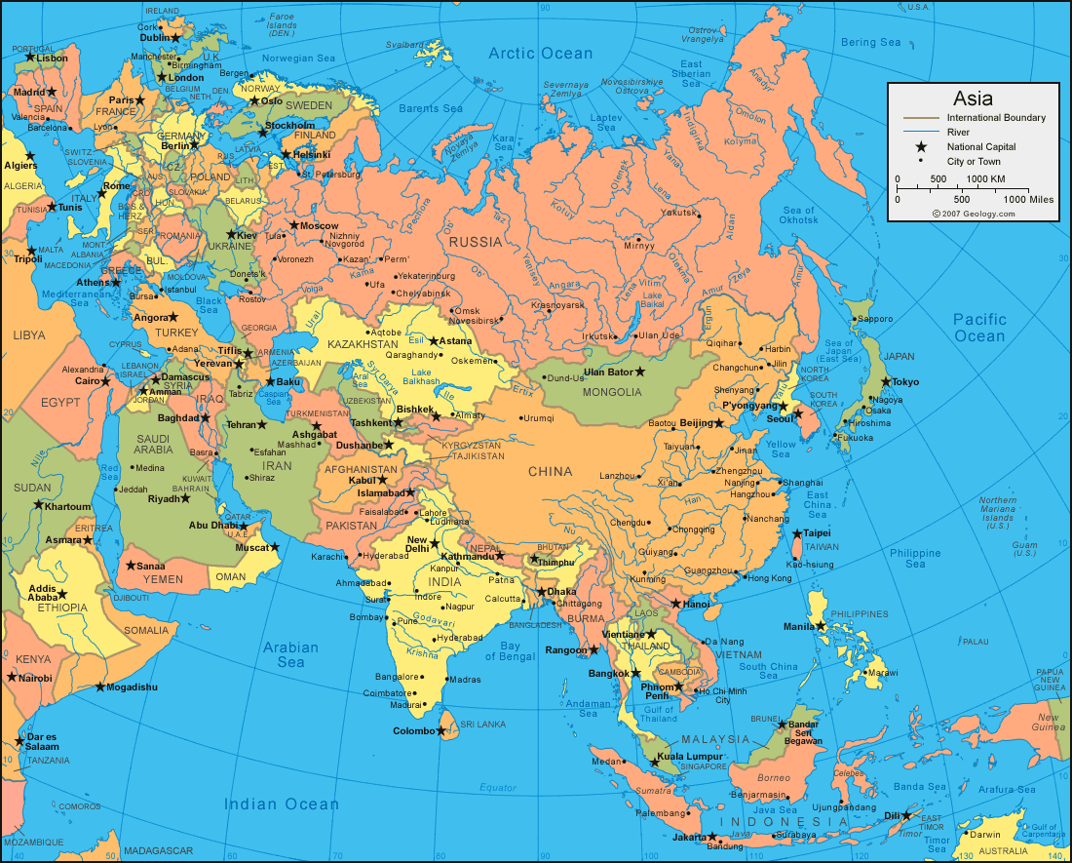
Geography and General Info
Population of Nizhny Tagil comprises about 390 thousand people.
Major local and regional industries are ferrous metallurgy, machine building, metalworking and chemical industry.
The regional and administrative center of Sverdlovsk region – Yekaterinburg – is located in 146km from Nizhny Tagil.
Europe
Chempark
China

Slide 3

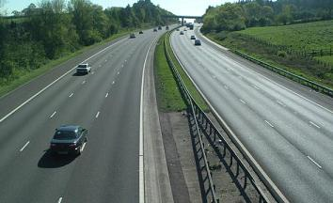
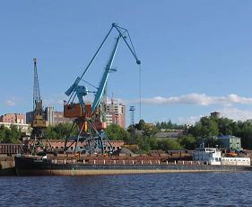
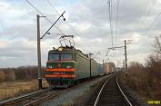
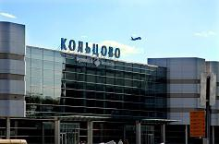
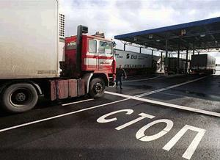
Logistic Connections
Regional highway Р353 to Yekaterinburg – 10 km away from Chempark. Access to federal highway М5.
River harbor in Perm – 370 km away from Nizhny Tagil
Federal Sverdlovsk railway road – 300 meters away from the site
Koltsovo Airport in Yekaterinburg – 140 km away from the site
  Customs post “Nizhnetagilsky” -
  5km away from the site

Slide 4
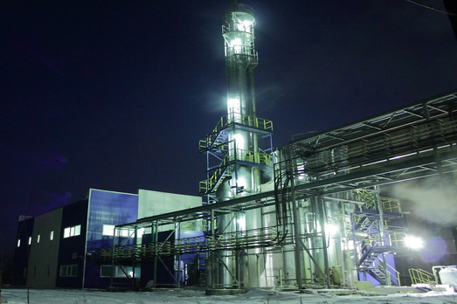
Site characteristic
The site is defined in a cadastral passport as "the land of settlements." Encumbrance of land is not registered.
The site is owned by JSC "Uralchimplast" that a certificate of state registration.
The main type of permitted use - for the operation of the industrial site with rail tracks, which fully corresponds to the current use of the site.

Slide 5
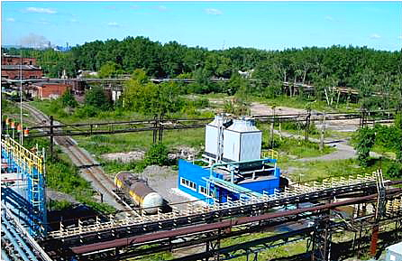
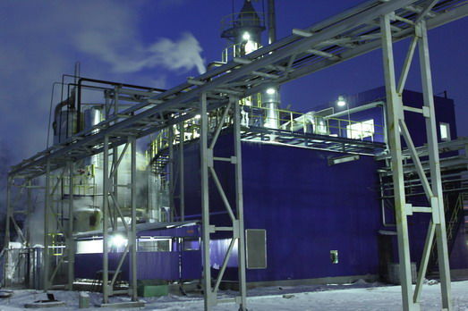
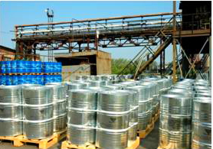
Chempark Infrastructure
Инфраструктура ХимПарка
Various energy resources available on site
Connection to energy resources supply points – free of charge!
Waste water treatment on owned up-to-date purification system
Industrial garbage landfill
Thermal treatment furnaces for chemical runoffs
On-site truck road system – total length about 35 km
On-site railway road system – total length about 35 km
Logistic services and warehouse facilities for raw materials
and finished products
Pipeline connections on site
Chempark area is under security check

Slide 6

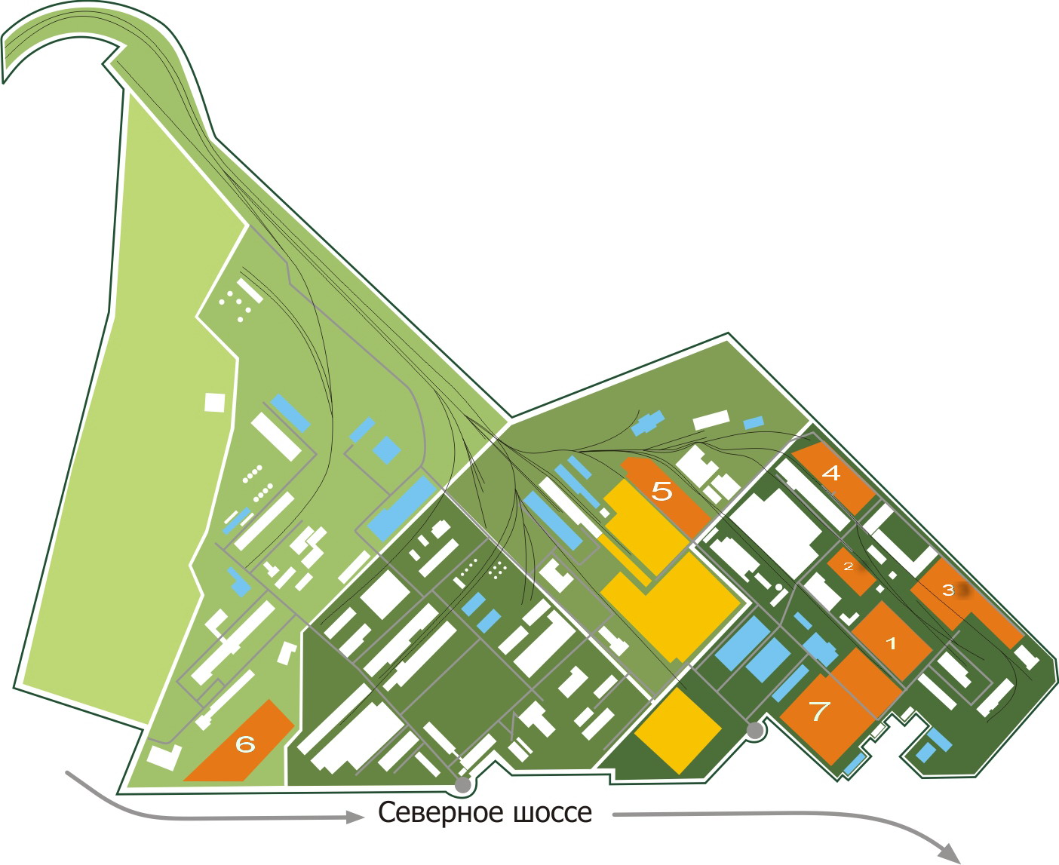
Chemical Park Tagil Area Outline
Non-occupied plots
Non-occupied buildings
Occupied areas
Uralmethanolgroup

Slide 7

Energy Resources Available on Site
Resource Type | Max. Total Capacity | Available Free Capacity
Natural gas | 40 000 m³ / h | 25 000 m³ / h
Power supply | 52.5 mW | 40 mW
Heat supply (steam) | 90 Gcal / h | 35 Gcal / h
Water supply | 1220 m³ / h | 800 m³ / h
Waste water purification and treatment facilities | 5 200 m³ / h | 870 m³ / h
Nitrogen | 200 m³ / h | 120 m³ / h
Compressed air | 7800 m³ / h | 2500 m³ / h

Slide 8
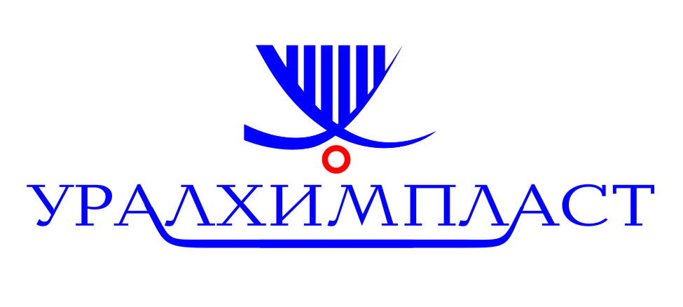
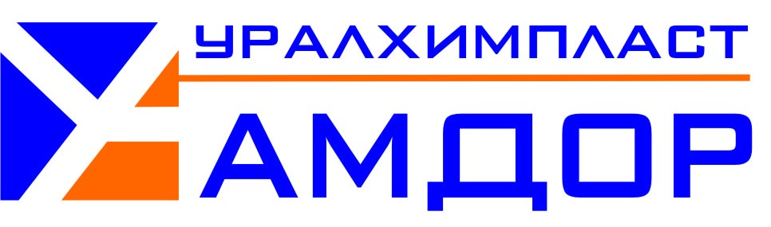






Major Residents & Projects
Burovik
Ecotechnologii - 2005

Slide 9
Current Projects
Total investment– 80 mln. rub. Capacity – 2 500 tn/y. Manufacture of adhesive agents and rust inhibitors.
Total investment – 19 bln. rub. Capacity– 600 000 tn/y. Manufacture of methanol
Total investment– 420 mln. rub. Capacity– 25 000 tn/y. Manufacture of the foundry & cast resins

Slide 10
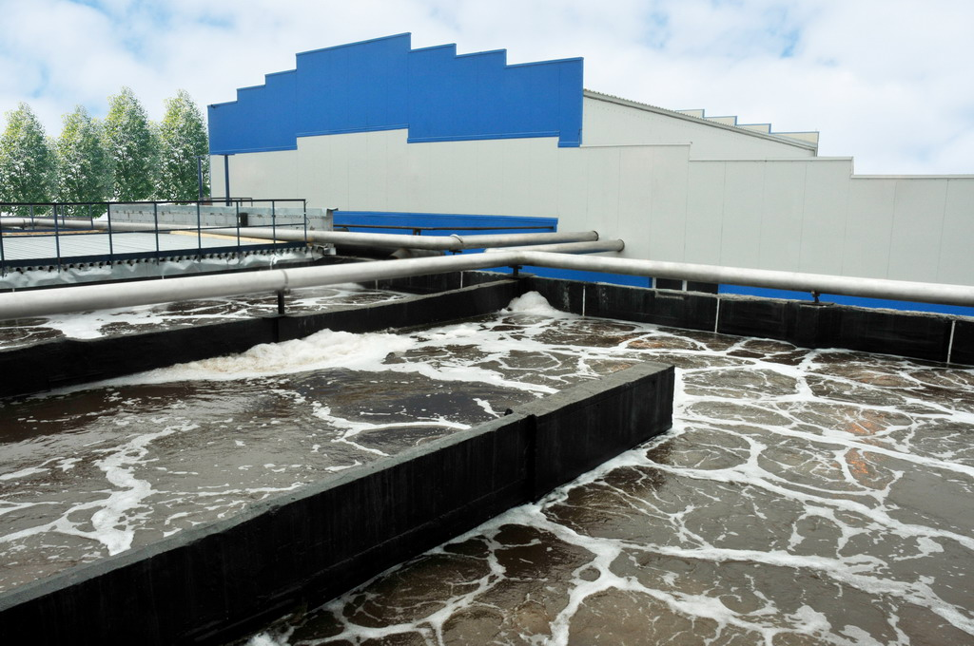
Biological Water Treatment Units
        Total annual capacity equals 49,5 mln. cubic meters
        New line annual capacity equals 5,5 mln. cubic meters

Slide 11
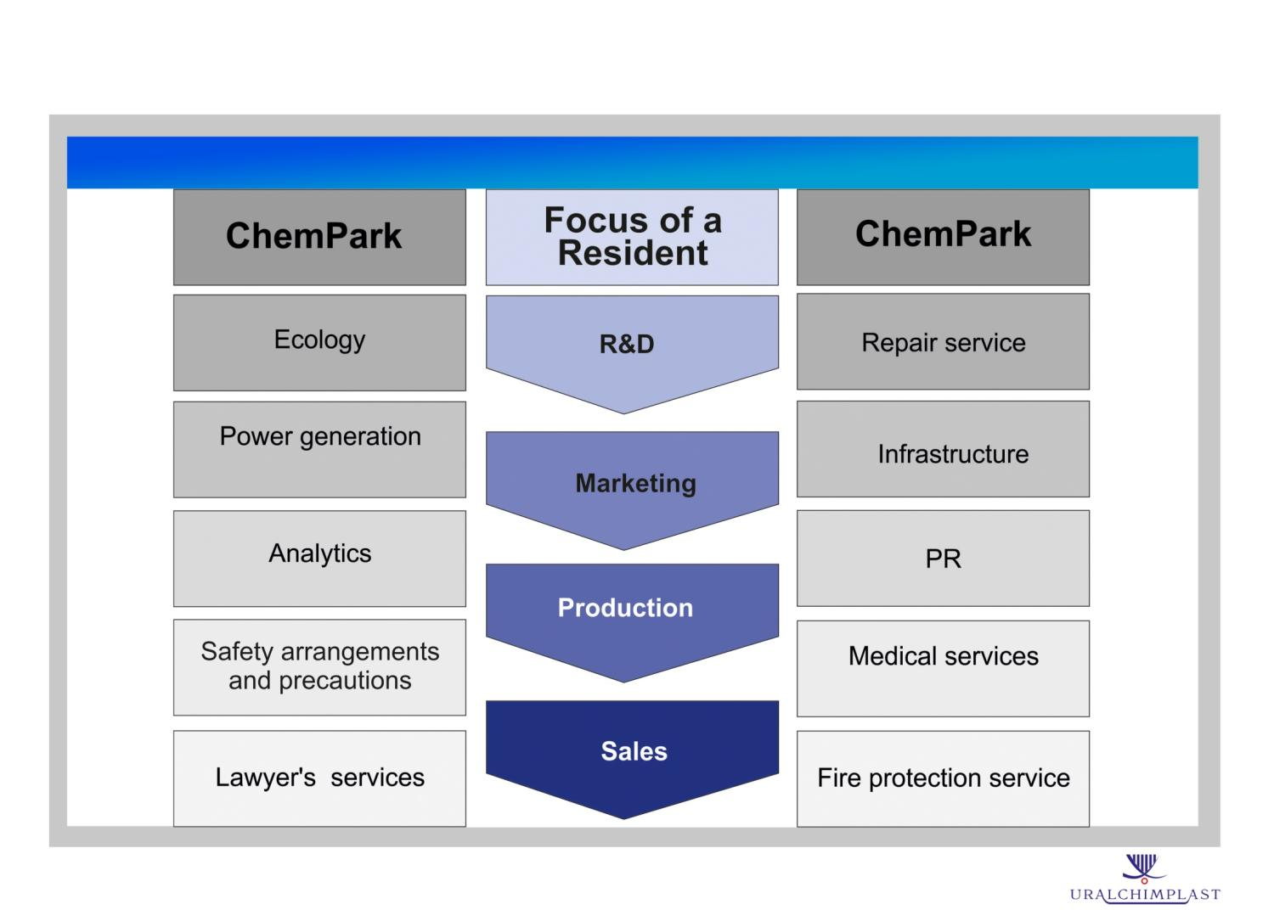
Advantages of Chempark «Tagil»
Full range of support services for residents

Slide 12


Cooperation with «Skolkovo» technopark
Industrial Trial Units to be located on the territory of Chempark Tagil
Certified
test
and research laboratory

Slide 13

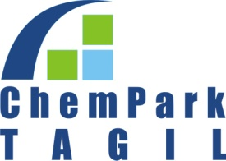

Financial Preferences & Cooperation

Slide 14
Welcome to Chemical Park Tagil!
CJSC MC Chempark Tagil.
622001, Nizhny Tagil, Sverdlovsk region, Russia.
Severnoe shosse 21, of. 7.
+7/3435/346201
+7/3435/346321 www.chptagil.com

