Slide 1

ULUANOVSK REGION
AVIATION CLUSTER

Slide 2

Scientific – educational – production cluster “Ulyanovsk – Avia” – Consortium with activity focused on Ulyanovsk region aviation
industry products and services ompetiveness enhancement.
Economical sector
Cluster management
Project research sector
Production sector
Personnel training sector
Air transport sector
Aviation sports sector

Slide 3
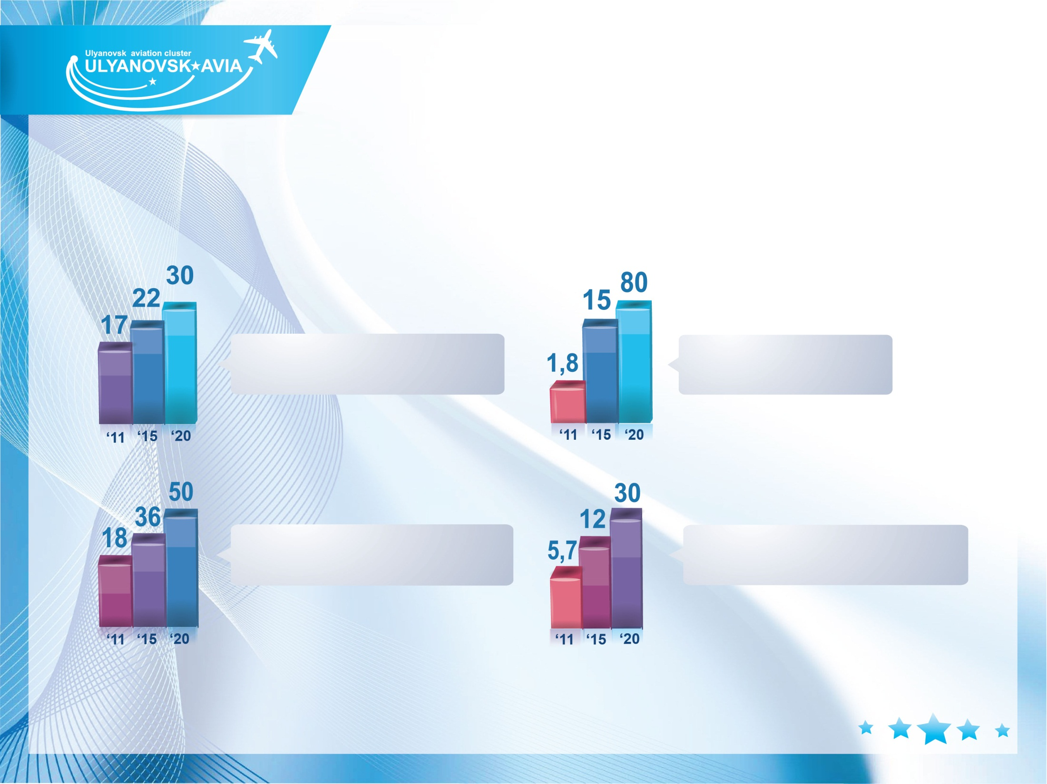
CLUSTER OPERATIONS
EFFECTIVENESS VALUATION
Growth dynamic 2011, 2015, 2020
Investments
volume, mln rbl.
Personnel, th.
Aviation industry share in GRDP, %
Average wages, th.rbl.

Slide 4

CLUSTER MANAGEMENT
Consortium “Scientific – educational – production cluster “Ulyanovsk Avia” had been created under initiative of Ulyanovsk region Government in August 2009.
Ulyanovsk region Government
Supervisory Board
Management Company “Ulyanovsk region aviation
cluster development”

Slide 5


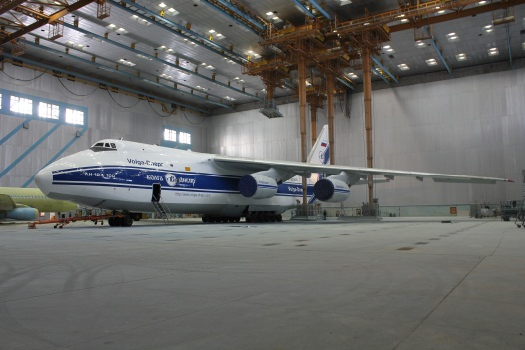

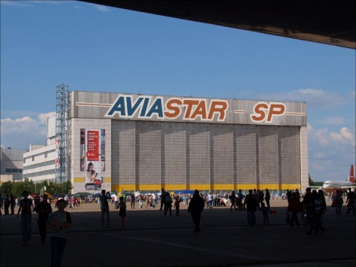

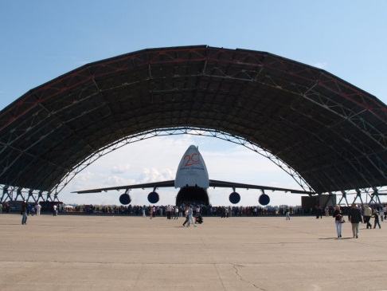


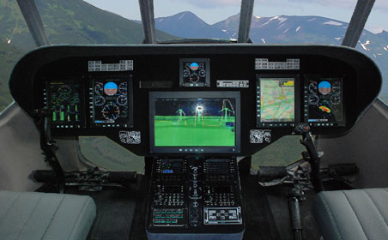

PRODUCTION SECTOR
OJSC Spektr-Avia
Aircraft and aviation instruments production and repair.
Modern aircraft paint shop
CJSC Aviastar-SP
Company specialized in wide body
transport and regional aircraft pro-
duction (Tu-204, An-124, Il-76MD-90A).
OJSC “UIMDB”
OJSC “UTYOS”
RF industry leaders in avia instruments
production with activity based on develop-
ment, manufacture and aviations
Introduction.
CJSC AeroCompozit
“Black wing” parts production
HATLEC LLC
Development of the projects of companies
modernization under“turn key” terms, Enginee-
ring services, training of technologists-program-
mers and CNC operators, airspace parts production

Slide 6
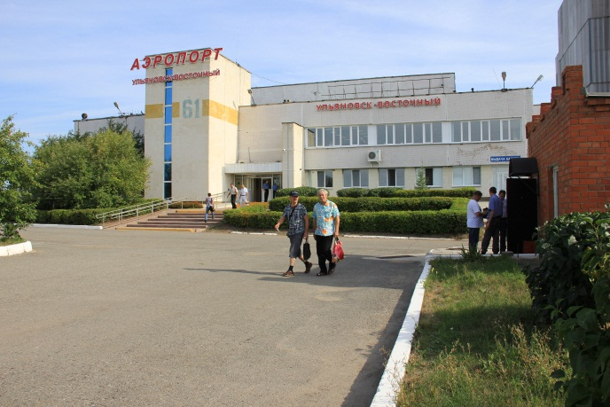

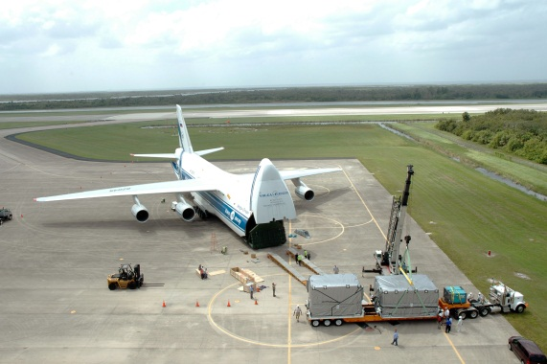

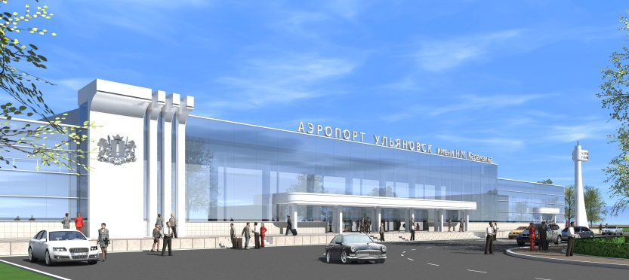

AIR TRANSPORTATION SECTOR
Air passenger and cargo transportation, MRO
Ulyanovsk-Vostochny
international airport
Base land for SEPZ.
International status, Customs terminal.
I-st category ICAO certified.
Runway – 5100m x 105 m.
No limit for aircraft landing weight.
Capacity – up to 40 aircraft per hour.
Polet Airlines
Big air carrier at RF Central
federal district.
OJSC “Airport – Ulyanovsk”
I-st category ICAO certiified
Runway – 3826 m x 6 m capable to handle
all existing types of the aircraft, no limitations.
Volga-Dnepr Airlines
Leader of super heavy air international
transportation.

Slide 7
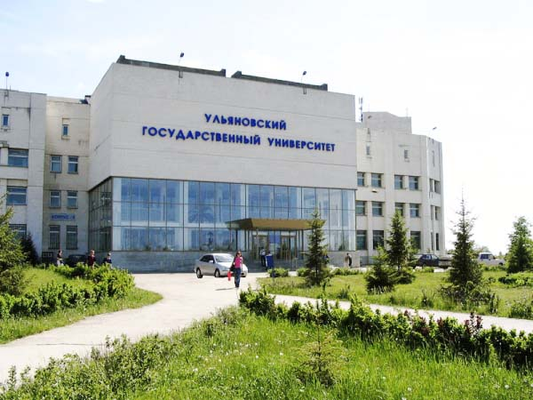
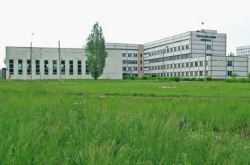

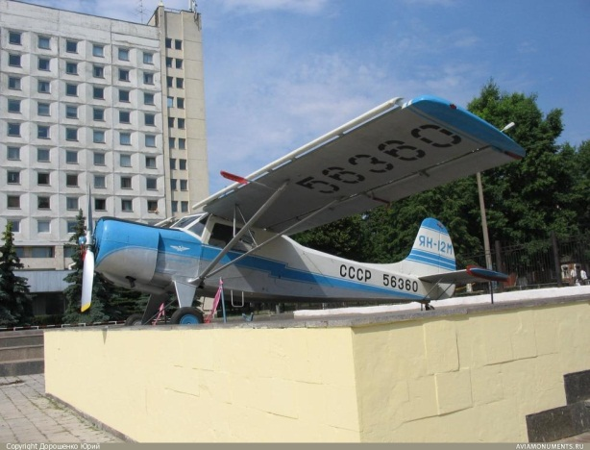

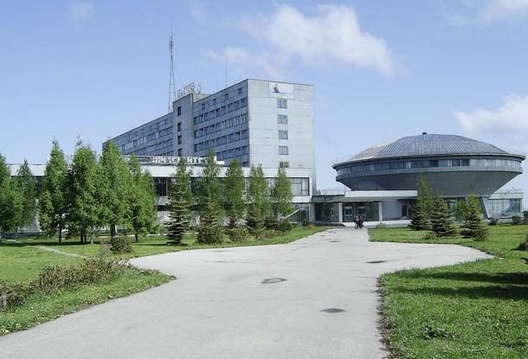
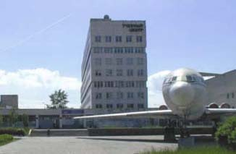



PERSONNEL TRAINING SECTOR
Training and retraining of personnel by high and
Secondary special aviation industry educational system.
Ulyanovsk
State
University
Ulyanovsk
Technical College
Ulyanovsk
Higher Civil Aviation School
Ulyanovsk
State Technical
University
Ulyanovsk
Aviation College

Slide 8
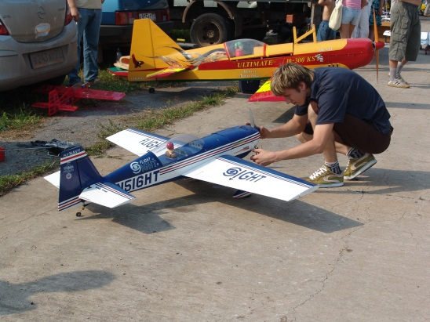



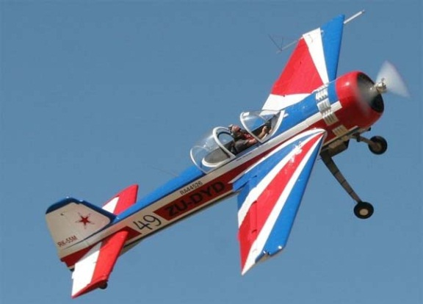
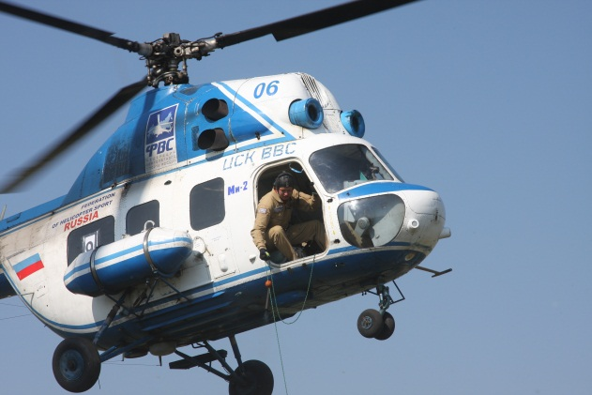
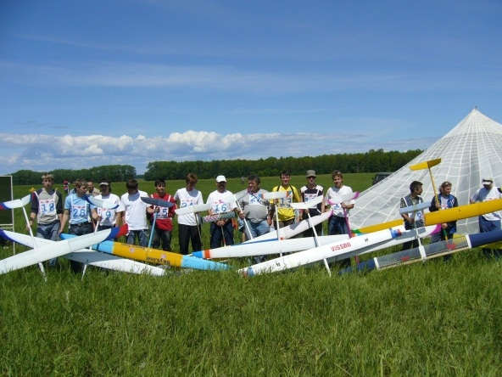
AVIATION SPORTS SECTOR
Popularization of aviation sport among wide circles of population: air show, sport contests. Youth training to work in aviation industry and military service.
Federation of aviation sports of the Ulyanovsk region
Ulyanovsk
aerotechnical
sports club
Ulyanovsk
DOSAAF club

Slide 9
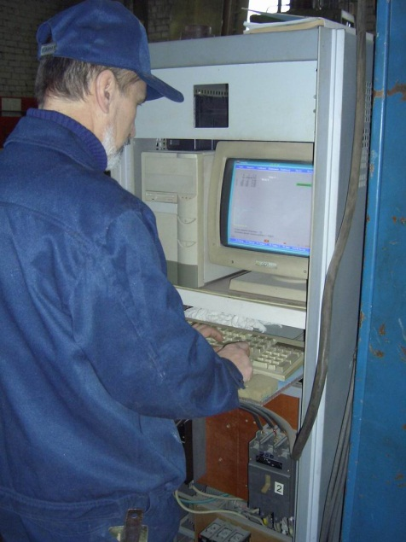


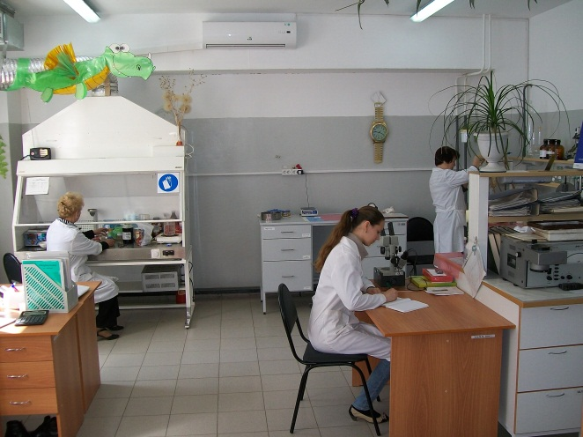

PROJECT RESEARCH SECTOR
Scientific – research and design development
in aviation area. Design of aviation Technique
and cluster infrastructure products.
OJSC Ulyanovsk NIAT
“Ulyanovsk scientific –
research institute of
aviation technology and
production processes.
Scientific production
activity in the area of
machine building.
“ARRIAM”
Ulyanovsk scientific – technological
center of the federal state enterprise
“All Russia Scientific – research
institute of aviation materials”
OJSC “IL” Design Bureau, Ulyanovsk branch
OJSC “Tupolev” Design Bureau, Ulyanovsk branch
Experimental DB, one of the
leading RF companies crating
sophisticated aviation technique
“Tupolev” DB Ulyanovsk affiliate
conducts R&D in the area of
technical and fundamental
Science.

Slide 10
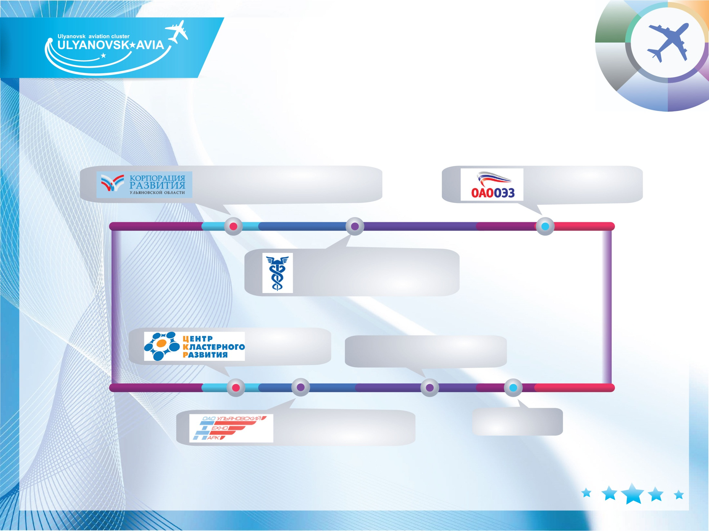
ECONOMICAL SECTOR
Creation of the comfortable environment for small and
middle sized business, cluster Infrastructure projects
implementation, innovative developments implementation.
Ulyanovsk region
Development Corporation
SEPZ affiliate
Ulyanovsk Chamber of
Commerce and Trade
ANO “CCD”
“Region-Vektor”
“Ulyanovsk technopark”
“UCTT” LLC

Slide 11

AVIATION CLUSTER STRATEGIC
PROJECTS
Free Port economic zone development.
Regional aircraft production organization at SEPZ.
Composite materials production by “Aerocompozit”.
An-124 “Ruslan” aircraft production re-start.
The modernized IL-76 production organizing.
Creation of the international Center for flight personnel
training and type rating for native and foreign made aircraft.
Creation of training Center for ground service personnel for native
and foreign made aircraft.
Aviation sports development.

Slide 12
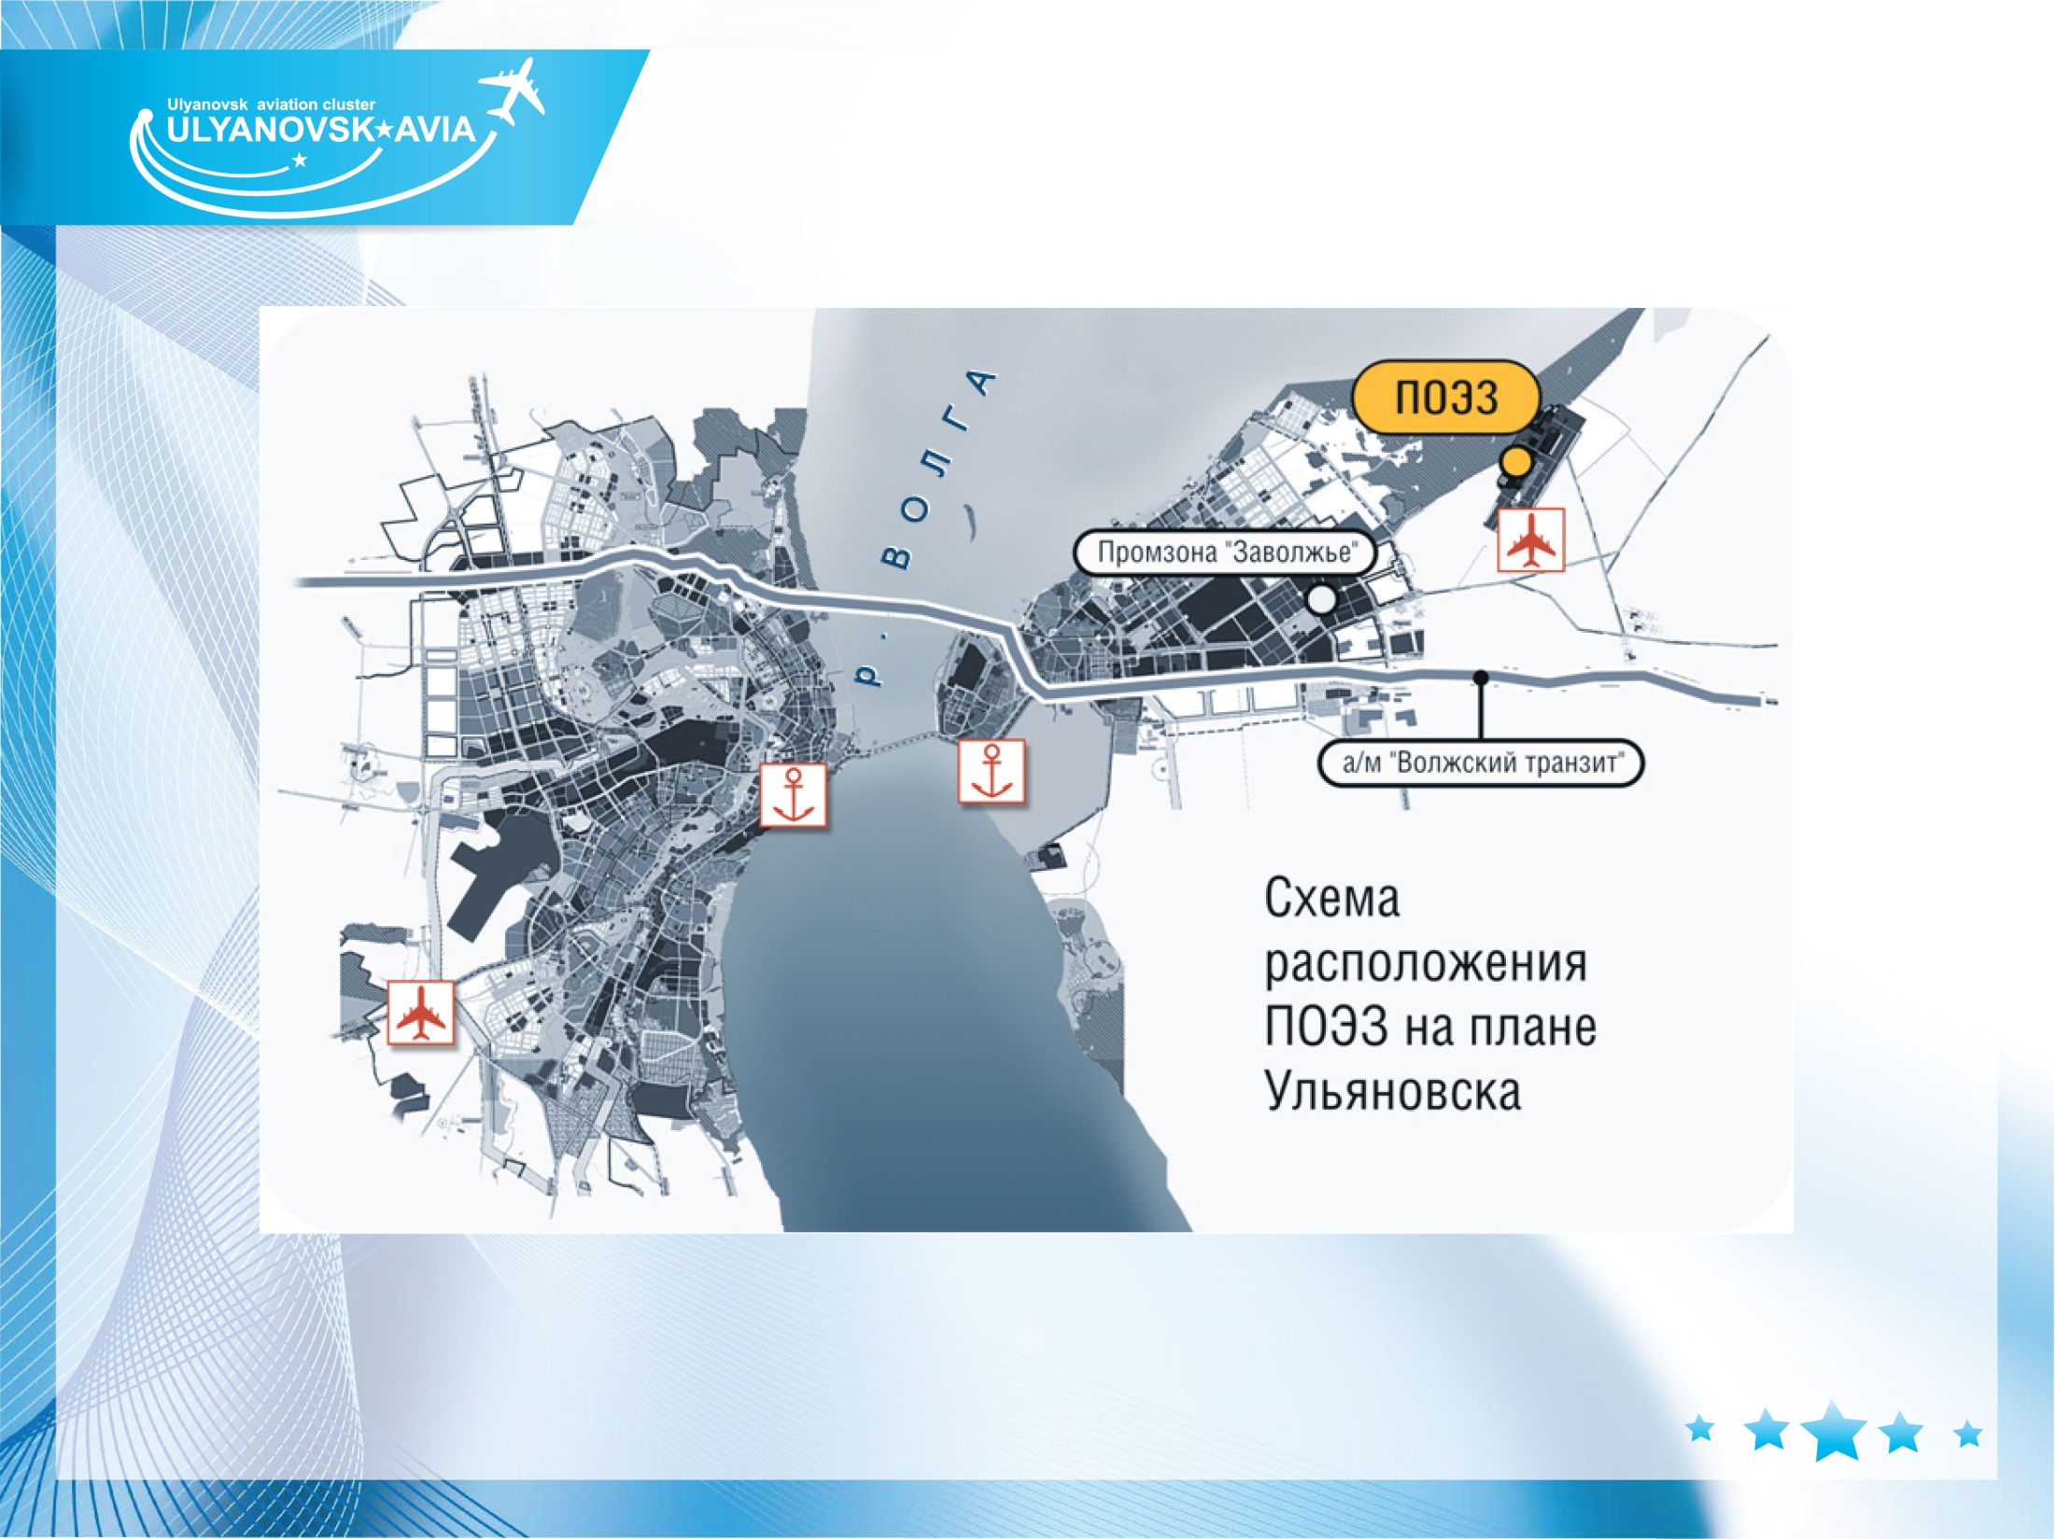
FREE PORT ECONOMIC ZONE
Scheme of Port Zone
location at
Ulyanovsk land
Total area of Port Zone planned – 640 Hr, whereas 120
Hr dedicated to 1-st starting complex

Slide 13

FREE PORT ECONOMIC ZONE
Attractive tax and customs initiatives.
Admin support of regional and federal authorities.
UNIQUE LOCATION NEAR:
Railway stations, connected by line to
Ulyanovsk –Vostochny” airport –
7,5 km
Federal motorway
Ulyanovsk – Vostochny
runway – 1,5 km
Cargo river port, capable to handle
passenger and cargo ships “river-sea”
type – 17 km

Slide 14

First and the only one in Russia business ground
dedicated to country civil aviation development
Infrastructural
companies
Logistics
operators
Aerospace
companies
State Government
representatives
Transport companies
including air carriers
Aviation components
and parts producers
Bank, insurance
companies

Slide 15
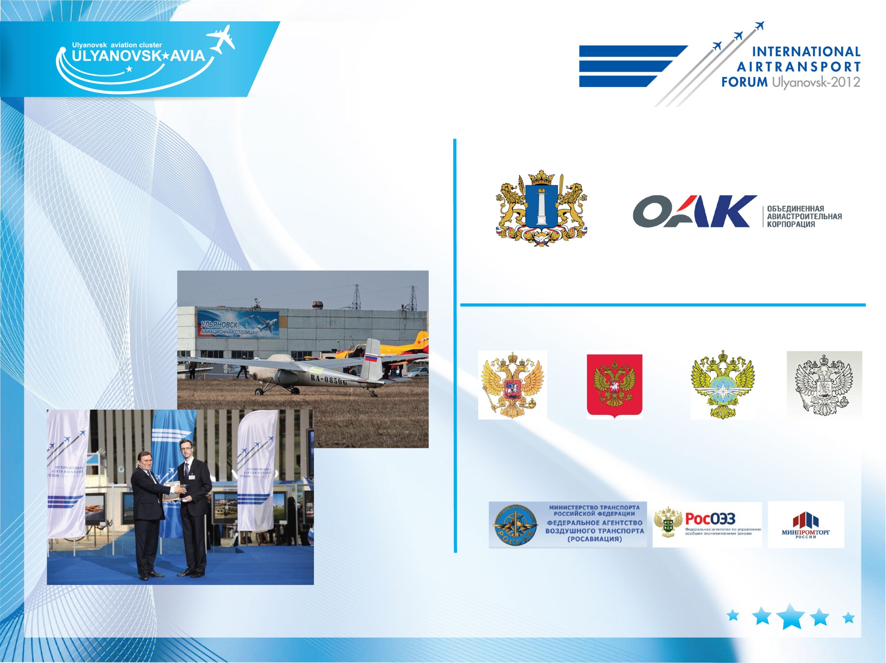
Equal to MAKS, Ulyanovsk Forum is the
biggest aviation event of Russia.
In accordance with the agreement between
MAKS and IATF, events will be conducted
Consequently.

Slide 16
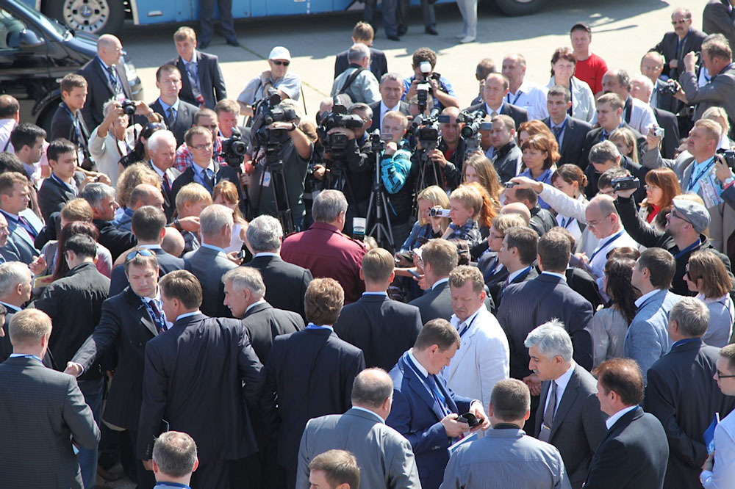
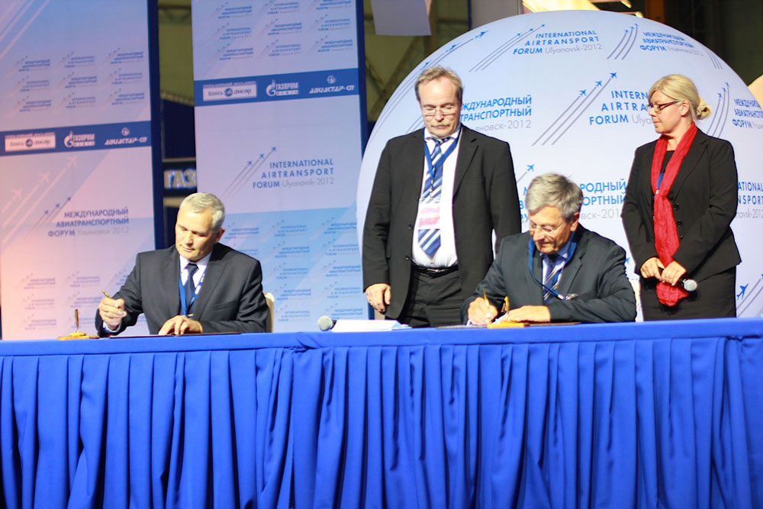
IATF-2012
1. International congress (16 countries, 2137 participants)
9 cooperation agreements,
Memorandum of the entering of “Ulyanovsk-Avia”
into the EAPS network.

Slide 17
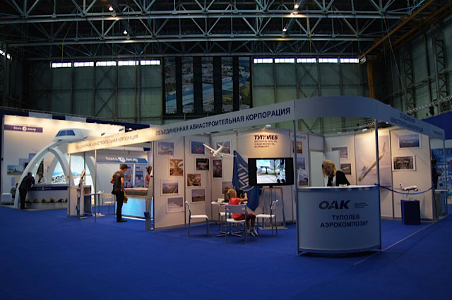
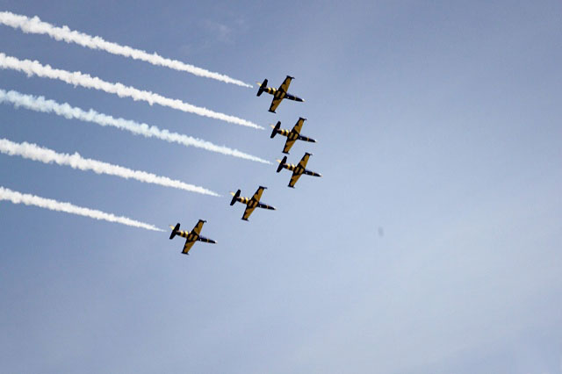
IATF-2014
2. International exhibition.
3. The first All-Russian Forum
of General Aviation.
4. Youth Aviation Forum
“I’m an Aviator”.
5. Airsow.

Slide 18

Thank you for your attention!

